Slide 1
IBM SKILL BUILD INTERNSHIP PROJECT REPORT
INTERN DETAILS
NAME : ZEENATH AMAN SHAIK
GMAIL ID : Zeenathamanshaik9312@gmail.com
COLLEGE : LAKIREDDY BALIREDDY COLLEGE OF ENGINEERING
STATE : ANDHRA PRADESH(MYLAVARAM)
INTERNSHIP DOMAIN : CYBERSECURITY
START DATE : 07-06-2023
END DATE : 05-07-2023

Slide 2
Problem Statement : ANALYZING THE IMPACT OF DOS ATTACKS ON NETWORK PERFORMANCE AND DEVELOPING EFFECTIVE MITIGATION STRATEGIES USING NS2.
A denial-of-service (DoS) attack is a tactic for overloading a machine or network to make it unavailable. Attackers achieve this by sending more traffic than the target can handle, causing it to fail—making it unable to provide service to its normal users.
→Simulate various DoS attack types (e.g., Ping Flood, SYN Flood).
→Measure performance metrics (packet loss, delay, throughput).
→Evaluate the effectiveness of defense mechanisms (e.g., traffic filtering, rate limiting).
→Utilize NS2 for controlled experiments and informed decision-making.

Slide 3
AGENDA
The presentation focuses on the topic of DOS (denial-of-service) attacks and demonstrates the use of NS2
(Network simulator 2) for simulating and analyzing their impact. It covers the introduction of DOS attacks, an
Overview of ns2's capabilities, and explores the simulation of DOS attacks using NS2. The presentation
A distributed denial of service (ddos) attack is a malicious attempt to disrupt the regular functioning of a network, service, or website by overwhelming it with a flood of illegitimate traffic.In a ddos attack, multiple compromised devices, often forming a botnet, generate high requests or traffic to overwhelm the target system’s resources, such as bandwidth, processing power, or memory.The objective of a ddos attack is to exhaust the target’s resources to the point where it becomes unavailable or experiences significant degradation in performance.

Slide 4
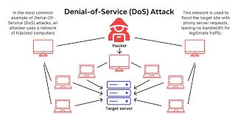
The objective of a DDoS attack is to prevent legitimate users from accessing your website. Unlike other types of attacks, attackers do not use DDoS to breach your security perimeter.
Instead, DDoS attacks are used to take down your website and prevent legitimate traffic, or used as a smokescreen for other malicious activities.

Slide 5
PROJECT OVERVIEW
developing defense mechanisms using ns2
→ Objective: study impact of dos attacks on network performance, develop effective defense mechanisms using NS2.
→ Background: dos attacks aim to disrupt network availability. Common types: ping flood, SYN flood. Motivations: political, financial, ideological.
→ Scope: simulate and analyze dos attacks in ns2. Evaluate defense mechanisms and their effectiveness.
→ Methodology: use ns2 for simulation and analysis. Measure performance metrics (packet loss, delay, throughput).
→ Defense mechanisms: explore traffic filtering, rate limiting, ids/ips. Collaborative defense strategies.
→ Experimental setup: design network topologies, configure ns2 for attack simulation. Evaluate performance metrics.
→ Results and analysis: present and analyze simulation results. Compare attack scenarios and defense mechanisms.
→ Conclusion and future work: summarize findings, recommend effective defense strategies. Explore advanced techniques and real-world implementation.

Slide 6
WHO ARE THE END USERS of this project?
Distributed Denial of Service (DDoS) attacks are generally launched by individuals or groups with malicious intent. These attackers, often referred to as threat actors, aim to disrupt the normal functioning of computer systems, networks, or websites by overwhelming them with a massive influx of traffic or requests.
While the attackers themselves are not considered end users in the traditional sense, there are several types of individuals or entities who may employ DDoS attacks for various reasons:
Hackers and Cybercriminals: Some individuals with advanced technical skills may launch DDoS attacks for personal gain, such as financial benefits through extortion or to cause disruption for ideological reasons.
Competitors or Rival Organizations: In some cases, competing businesses or organizations might use DDoS attacks to gain a competitive advantage by disrupting the services or online presence of their rivals.
Activists and Hacktivists: Certain individuals or groups engage in DDoS attacks as a form of protest or to advance a particular social or political agenda. These attacks are often motivated by activism or hacktivism.

Slide 7
YOUR SOLUTION AND ITS VALUE PROPOSITION
Denial of Service (DoS) attacks are becoming more frequent, it is a good time to review the basics and how we can fight back.
Network segmentation - Segmenting networks into smaller, more manageable pieces, can limit the impact of a DoS attack. This can be done by creating VLANs, and firewalls can limit the spread of an attack. The optimal solution is zero trust microsegmentation.
Cloud Mitigation Provider – Cloud mitigation providers are experts at providing DDoS mitigation from the cloud. This means they have built out massive amounts of network bandwidth and DDoS mitigation capacity at multiple sites around the Internet that can take in any type of network traffic, whether you use multiple ISP’s, your own data center, or any number of cloud providers. They can scrub the traffic for you and only send “clean” traffic to your data center.
Firewall – This is the simplest and least effective method. Generally, someone writes some Python scripts that try to filter out the bad traffic or an enterprise will try and use its existing firewalls to block the trafficInternet Service Provider (ISP) – Some enterprises use their ISP to provide DDoS mitigation. These ISP’s have more bandwidth than an enterprise would, which can help with the large volumetric attacks

Slide 8
How do you customize your project and make it your own?
Firstly, I followed the all sessions which helps a lot to do this project, the trainer also explained and cleared my doubts which helps me a lot in developing project.
The Dos attack is the project which is assigned to us, With the reference video, I am able to solved many queries regarding the project.
Reference journal also helped us in developing the project in our own way.

Slide 9
MODELLING AND ENHANCING PROJECT WITH ACKET COUNTING
Here, I used ubuntu for project.
Ubuntu was introduced in 2004 by a British company Canonical. It was based on Debian – a popular distro back then – which was difficult to install.
Incorporate packet counting as an additional performance metric.
Modify NS2 simulation setup to include packet counting functionality.
Capture data on total packets transmitted, received, and dropped during attack scenarios.
Analyze packet count changes with different attack types or intensities.
Correlate packet count with other performance metrics.
Gain insights into network behavior and evaluate defense mechanisms' effectiveness in mitigating packet loss.
Enhance project's analysis by providing a more comprehensive understanding of DoS attack impact on
network stability.
By incorporating packet counting, you can gather valuable data on packet transmission, reception, and loss,
allowing for a deeper analysis of network

Slide 10
PRINCIPLES
Here, I used some technology principles to over come the dos attack
The tcp (Transmission control protocol,) and udp (user datagram protocol ) are used for network flooding.
Firewalls are effective because they can block the offending IP addresses or the ports they're attacking. This has the drawback of also blocking legitimate requests through those ports, however. Intrusion prevention systems (IPS) are designed to detect server requests that are not legitimate and deny them.

Slide 11
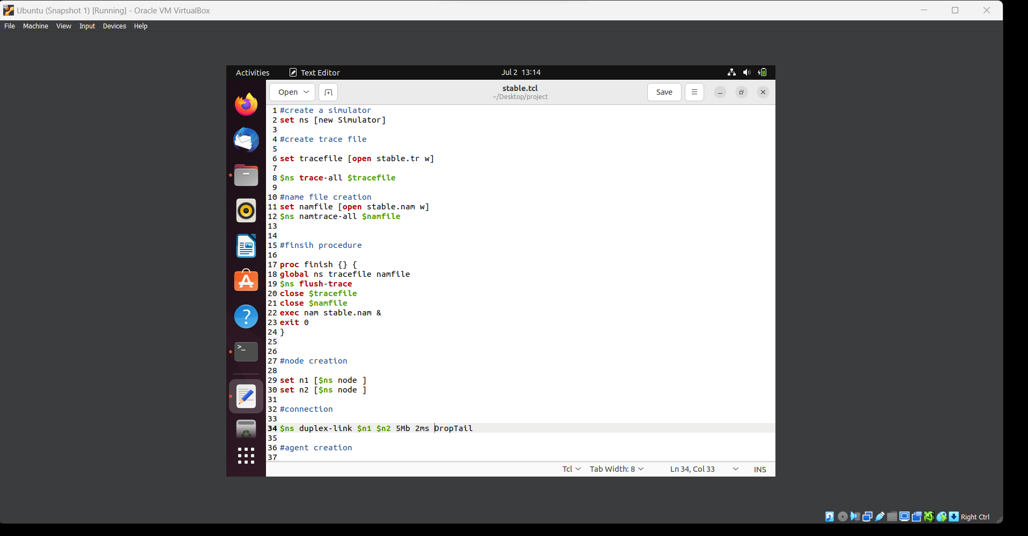
CODE FOR STABLE.TCL FILE

Slide 12
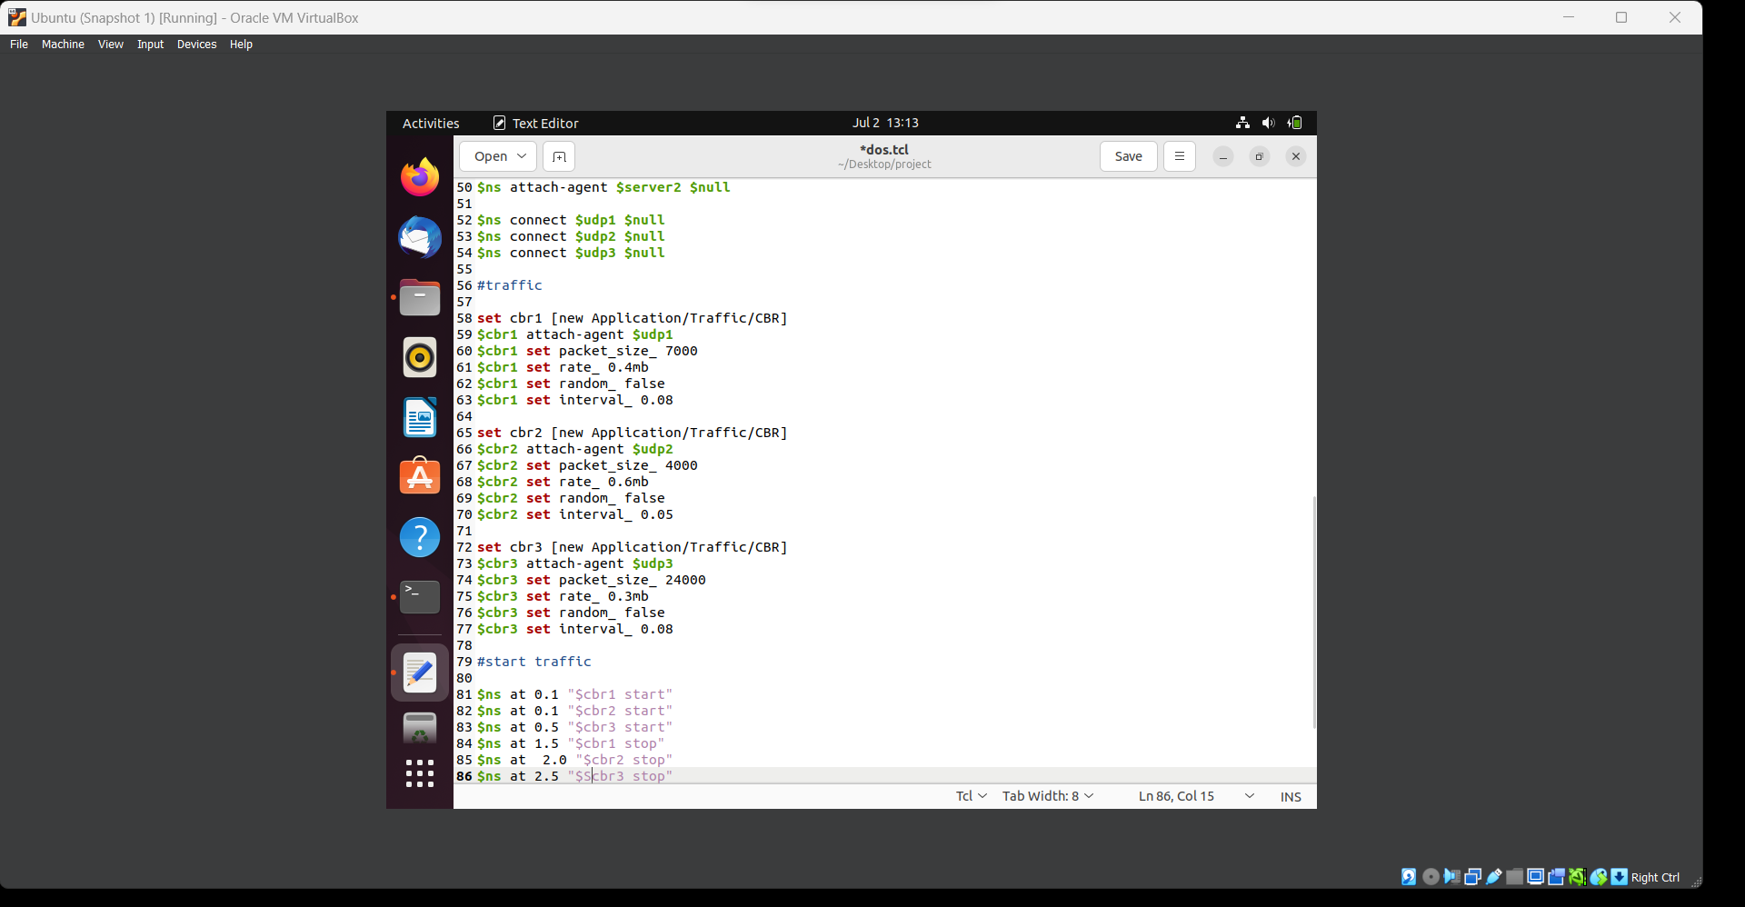
code for DOS

Slide 13
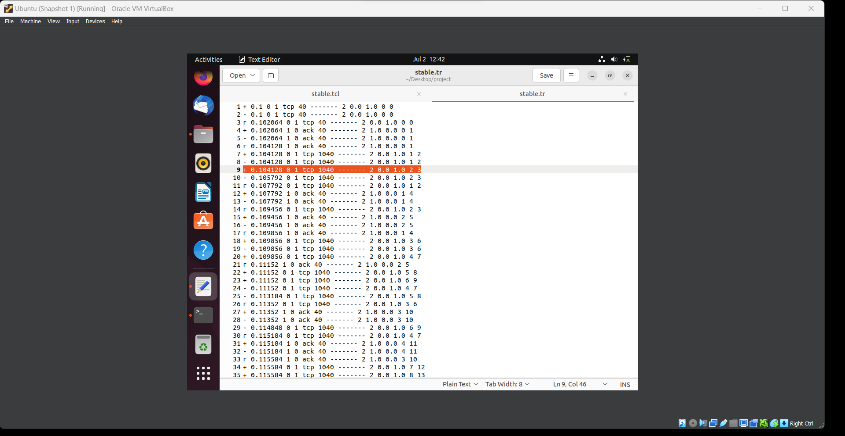
Results
Output for tcp(transmission control protocol)

Slide 14
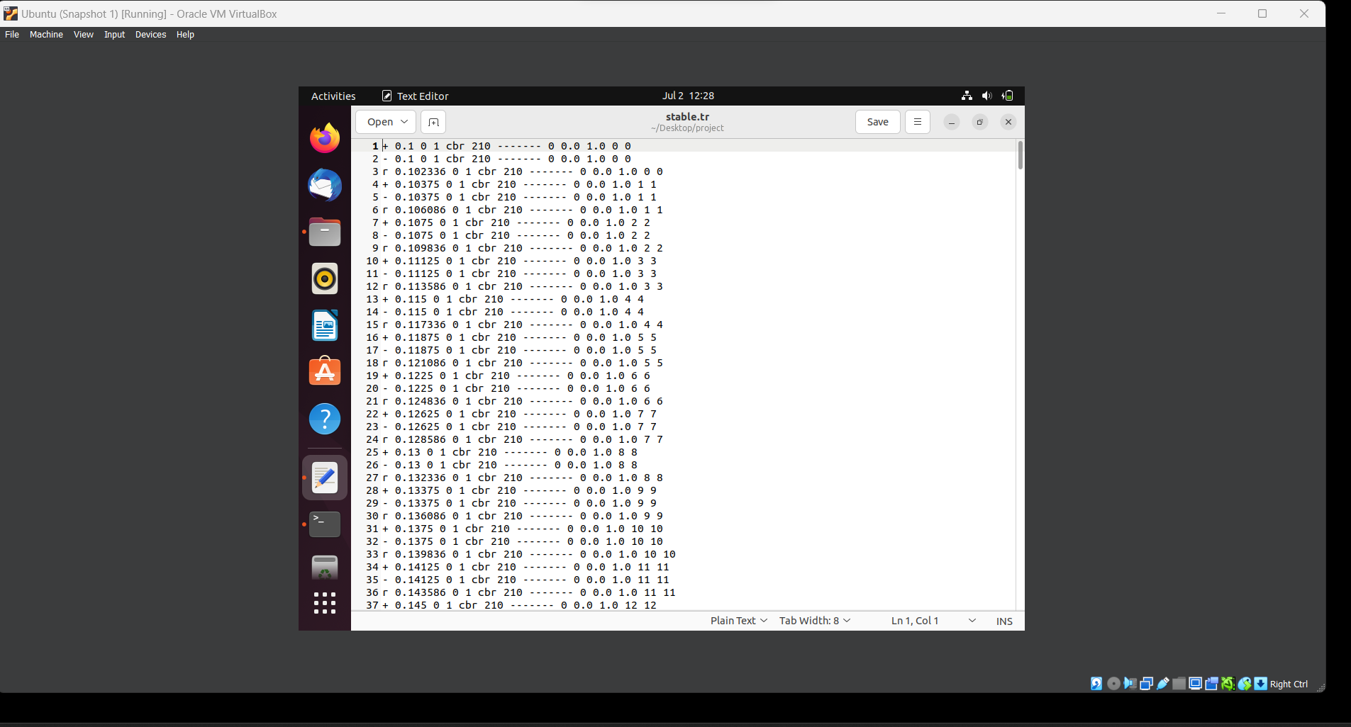
Output for udp (user datagram protocol)

Slide 15
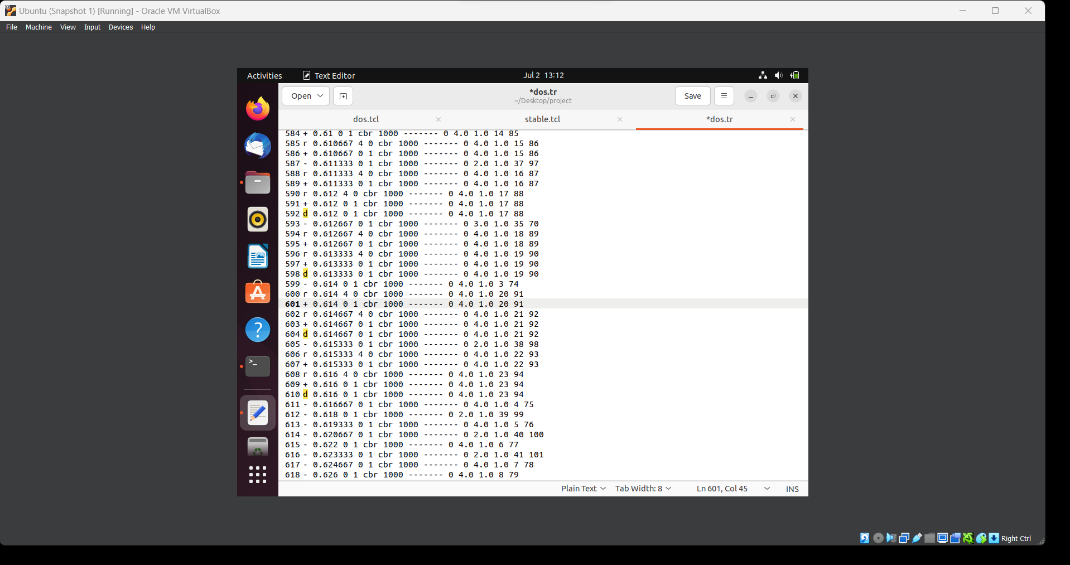
output for dos(denial of service)

Slide 16
links
Here ,I followed the reference video which the trainer uploaded in our respective group and also ,I followed the reference journal for the complete understanding about my project
Here the reference journal link:
https://www.mdpi.com/1424-8220/19/7/1542
https://www.linuxvmimages.com/images/ubuntu-2304/ - for kali linux download
https://networksimulationtools.com/how-to-install-nam-in-ns2-ubuntu/ -for nam installation
https://networksimulationtools.com/how-to-install-ns2-on-ubuntu/ -for ns2 installation

